Slide 1
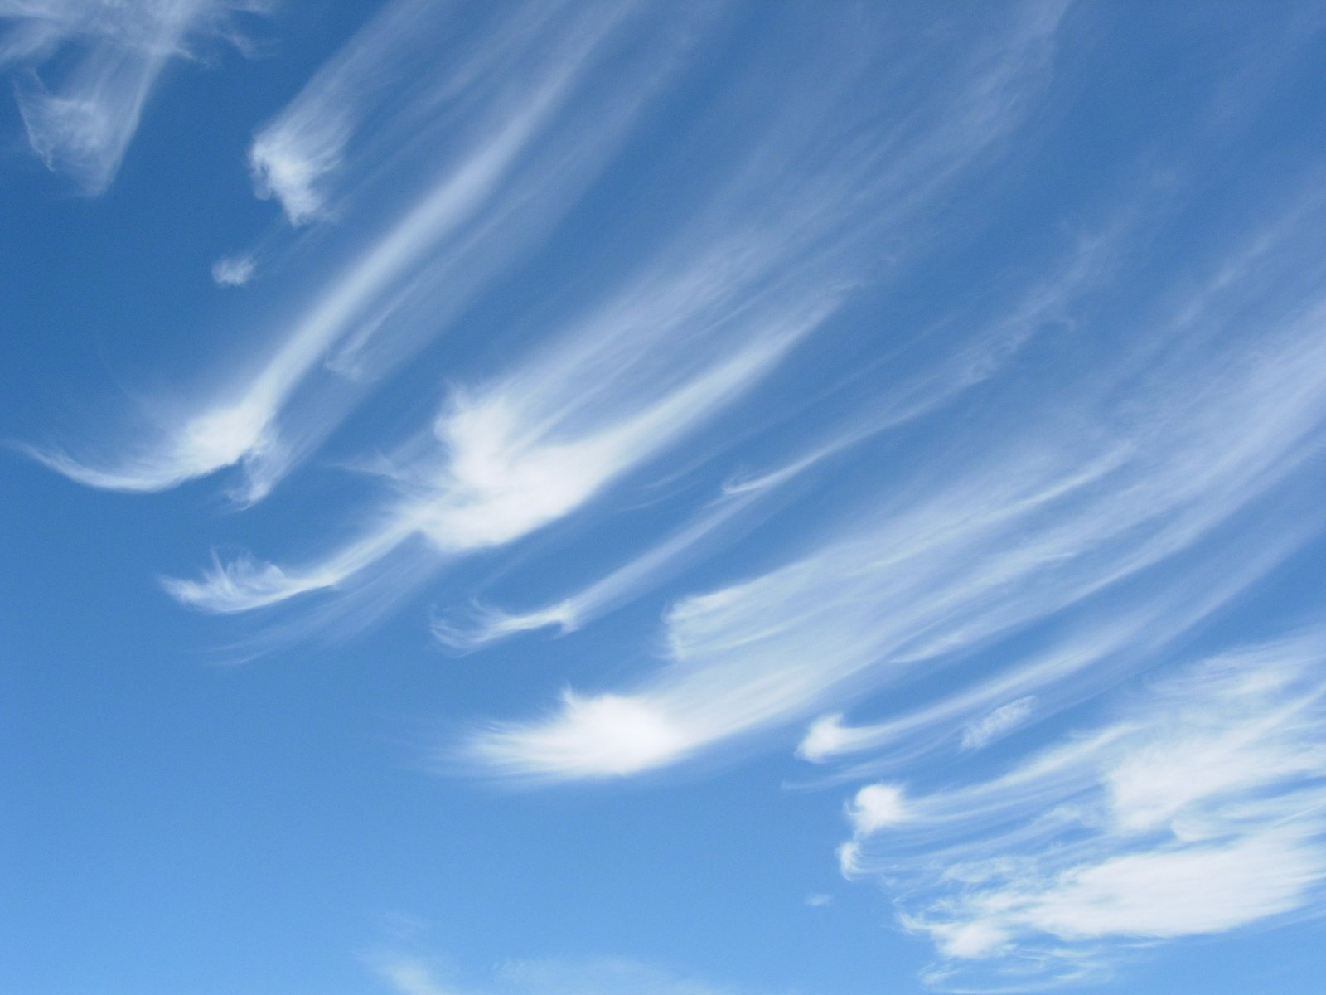
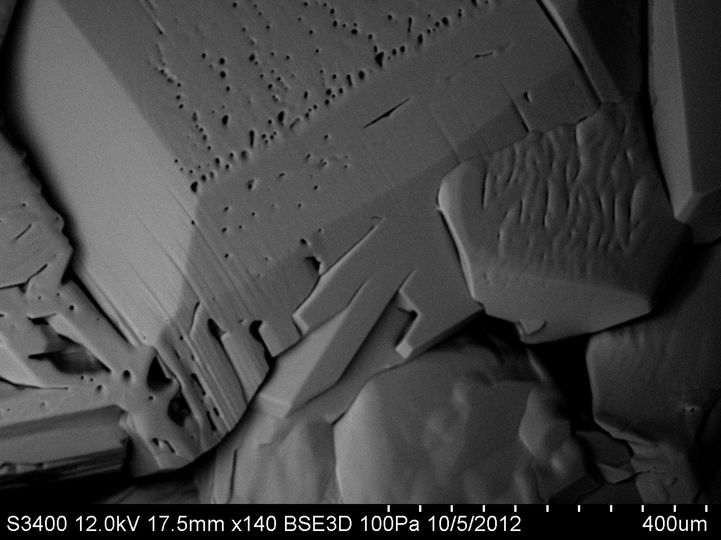
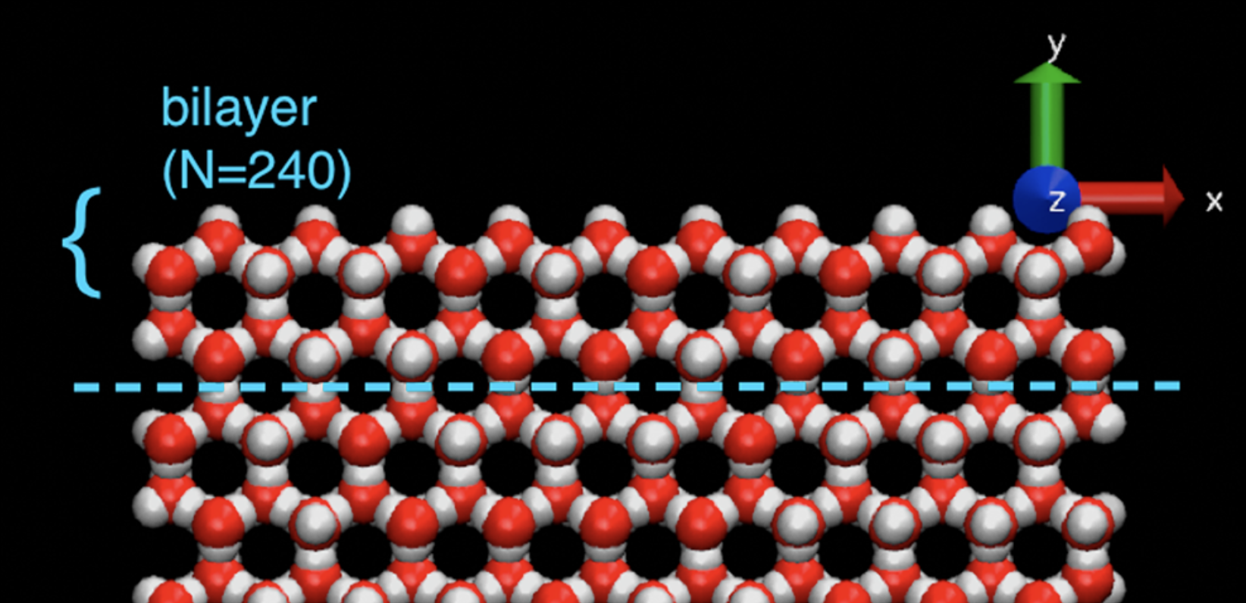

Three scales of ice
Atmospheric
M$esoscopic$
Molecular

Slide 2
Here I’ll be focusing on the molecular and mesoscopic
Atmospheric
M$esoscopic$
Part I:
How do growing ice surfaces remain flat?
Part II:
How do they become rough? (Actually, what is roughness?)
Molecular

Slide 3
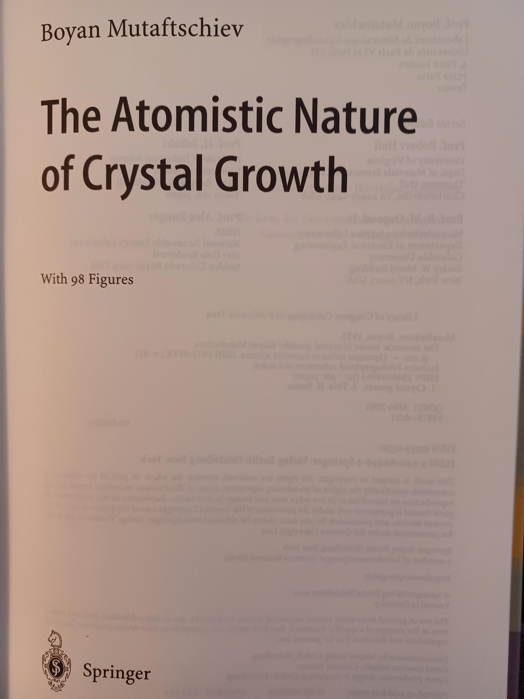
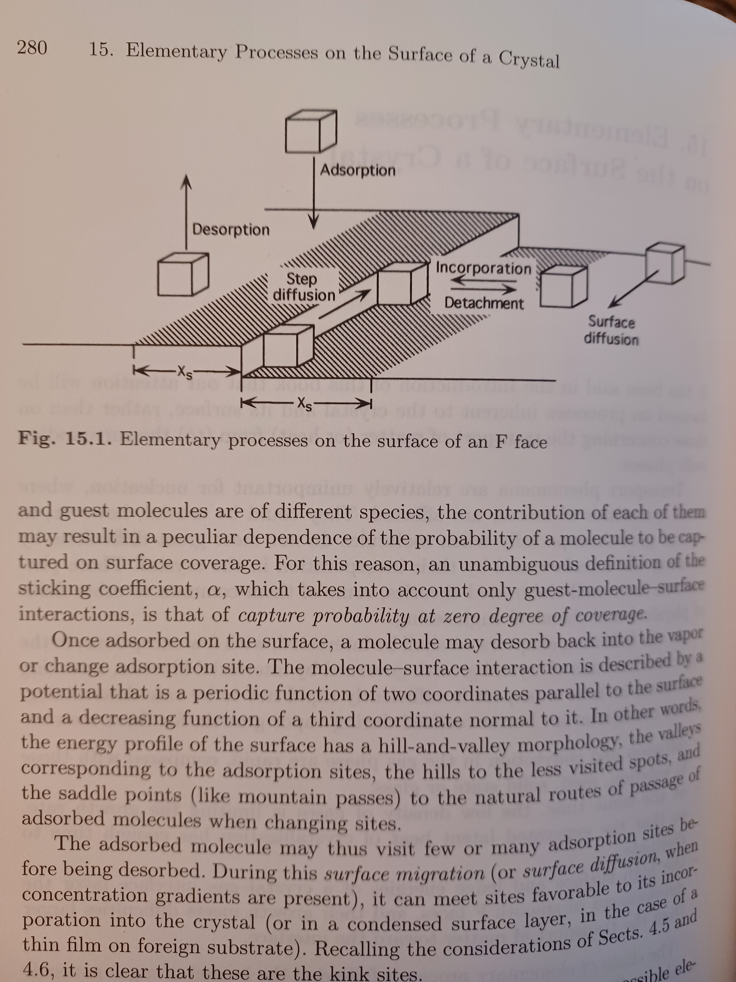
We’d like to describe these behaviors in a way pioneered by BCF (and others) …

Slide 4
We’d like to describe these behaviors in a way pioneered by BCF (and others) …
… But we can’t because of the pesky quasi-liquid layer

Slide 5
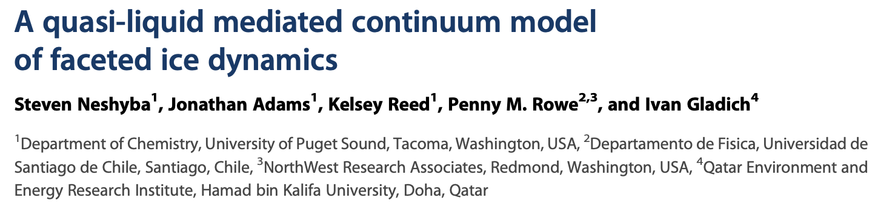
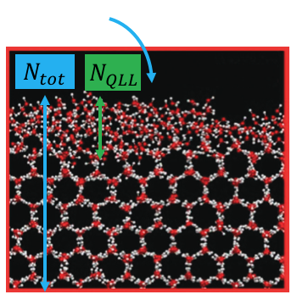
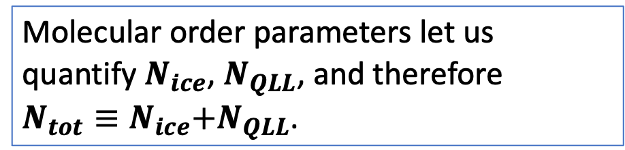
Which led to a paper back in 2016 in which we tried to span those two scales
prismatic surface
prismatic surface
Molecular order parameters let us quantify $N_{ice}$, $N_{QLL}$, and therefore
$N_{tot}≡N_{ice}\text{+}N_{QLL}\text{.}$
basal surface
We have a mathematical criterion

Slide 6
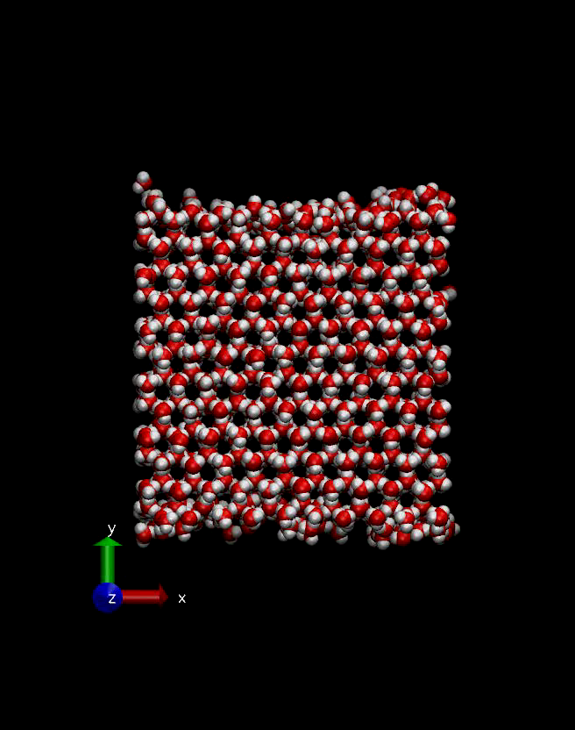
Here are the kind of numerical experiments we did
The time for this simulation is picoseconds, but after a few nanoseconds, we could get “equilibrium” thicknesses of the QLL.
basal surface
We have a mathematical criterion

Slide 7
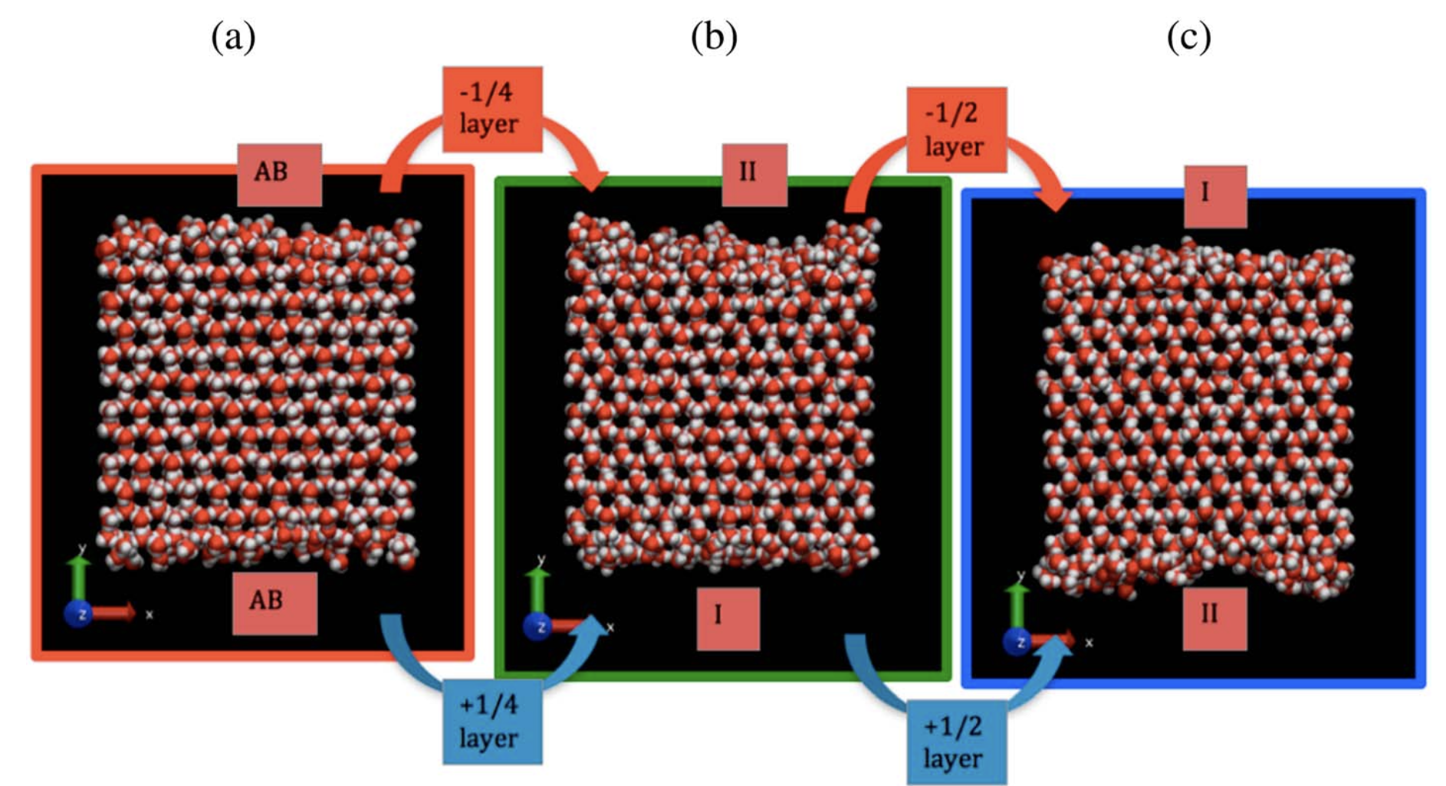
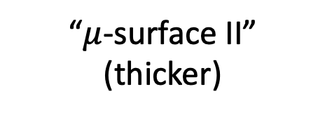
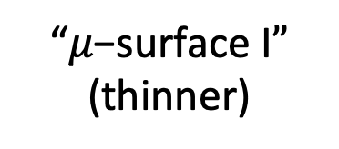
We found a periodic variation in $N_{QLL}^{eq}$ as a function of $N_{tot}$
“$μ\text{−}\text{surface} \text{I}”$
(thinner)
“$μ$-surface II”
(thicker)

Slide 8
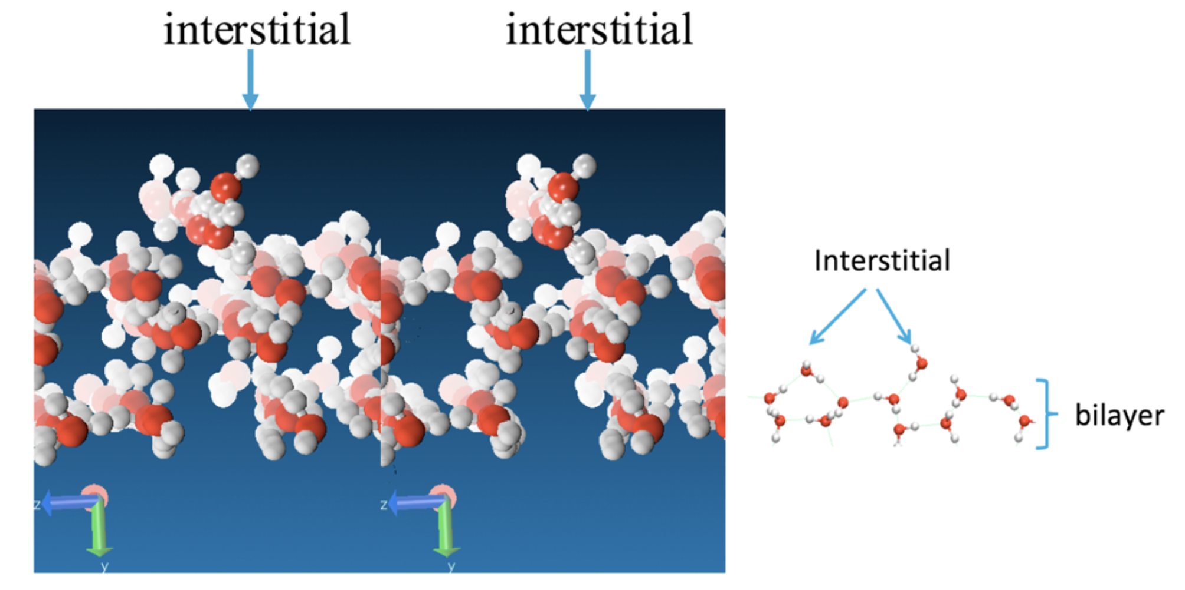
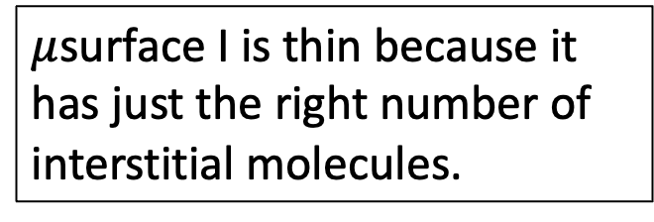
We think we understood why the variation occurs
$μ$surface I is thin because it has just the right number of interstitial molecules.

Slide 9
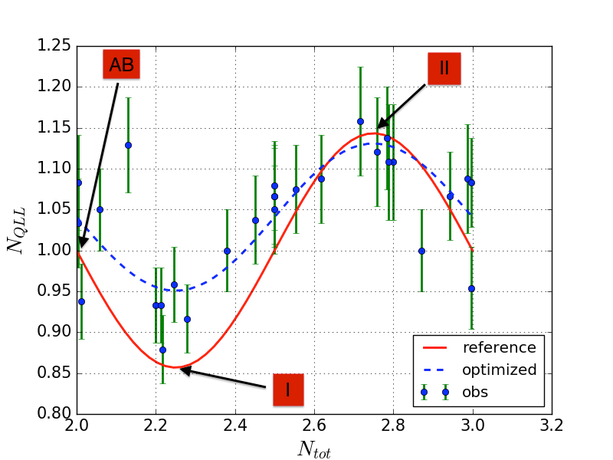
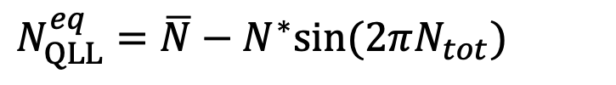
A rough description of that variation as a function of $N_{tot}$
$N_{QLL}^{eq}=\overline{N}−N^{∗}sin⁡(2πN_{tot})$

Slide 10
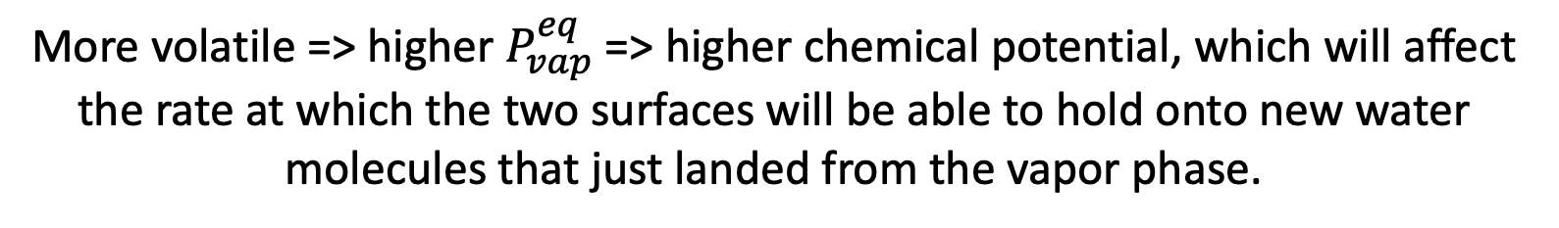


The simulations also predicted that $μ$surface II is more volatile than $μ$surface I.
$μ$surface II
$μ$surface I
More volatile => higher $P_{vap}^{eq}$ => higher chemical potential, which will affect the rate at which the two surfaces will be able to hold onto new water molecules that just landed from the vapor phase.

Slide 11
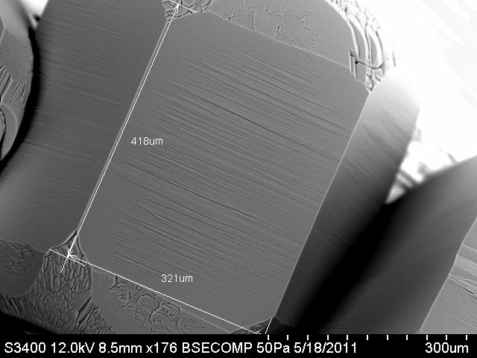
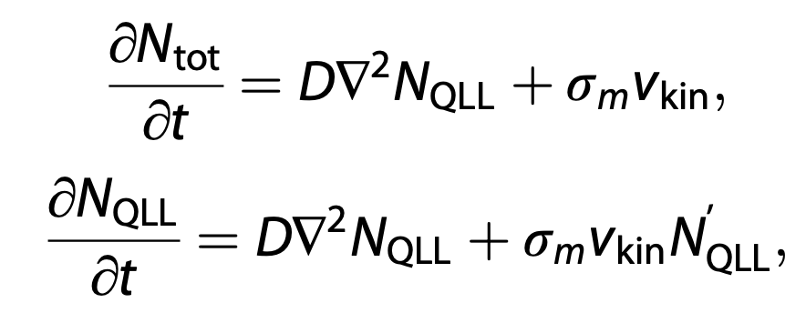
Scaling up to the mesoscale (or SEM scale) led to a pair of partial differential equations …
… of which I’ll be describing a revised version here.

Slide 12
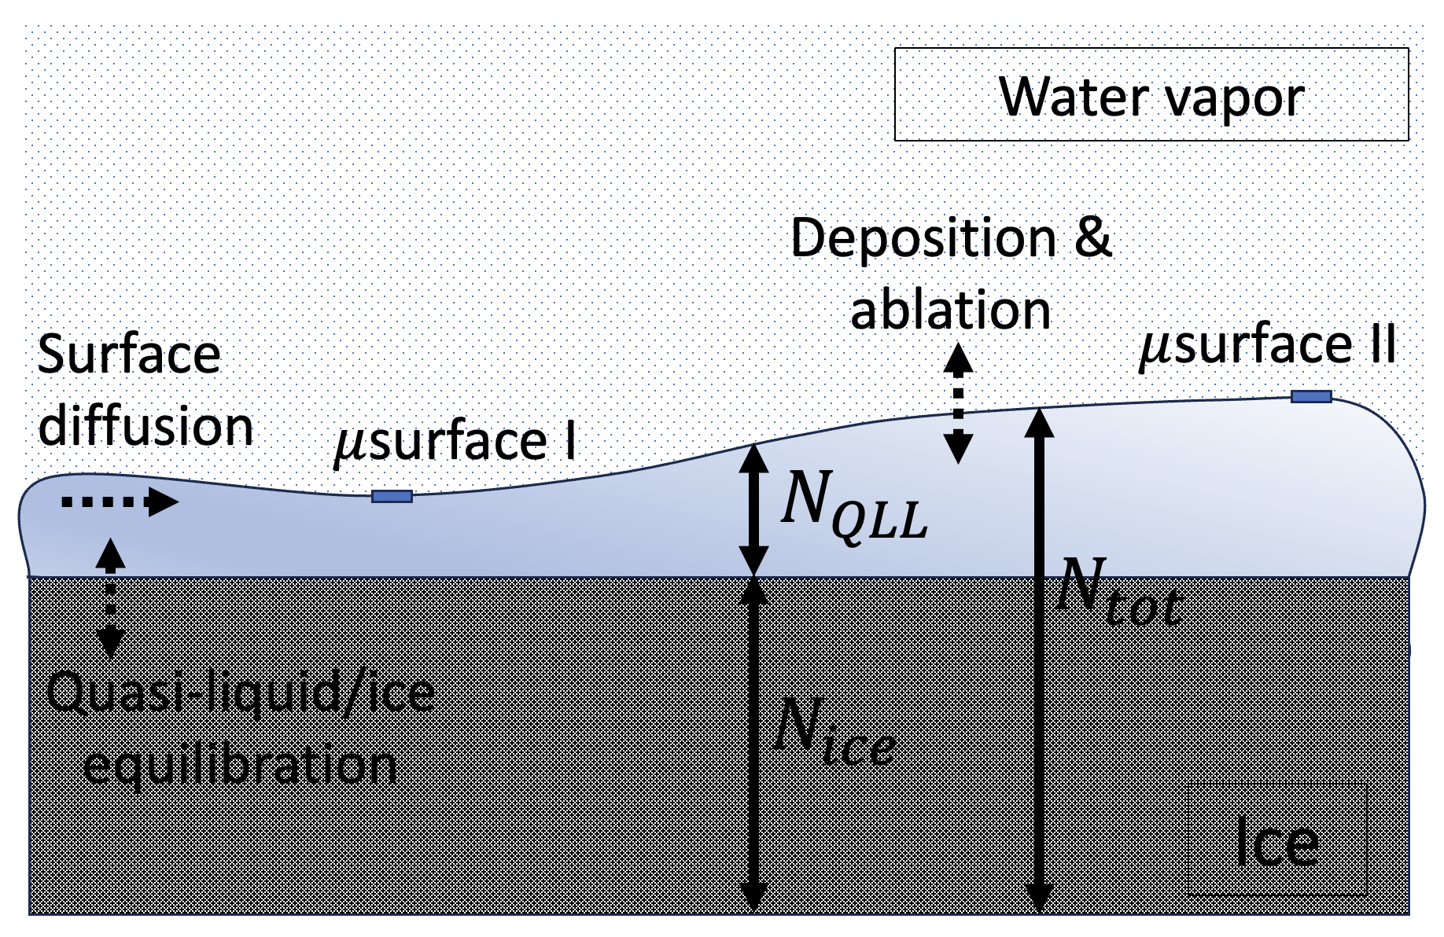
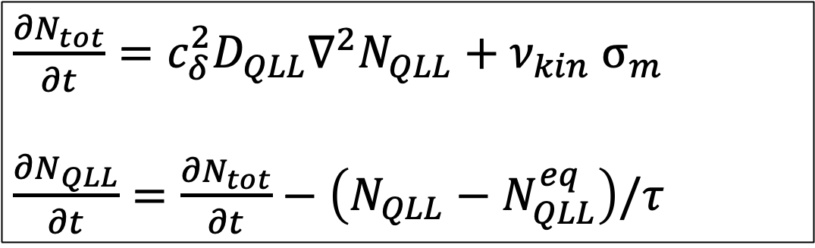
Two coupled PDEs and the processes they’re meant to represent
$\frac{{∂N}_{tot}}{∂t}={c_{δ}^{2}D}_{QLL}∇^{2}N_{QLL}+ν_{kin}$ $σ_{m}$
$\frac{{∂N}_{QLL}}{∂t}=\frac{{∂N}_{tot}}{∂t}−\left(N_{QLL}−N_{QLL}^{eq}\right)/τ$

Slide 13
Interconversion of quasi-liquid with the underlying ice lattice
$\frac{{∂N}_{tot}}{∂t}={c_{δ}^{2}D}_{QLL}∇^{2}N_{QLL}+ν_{kin} σ_{m}$
$\frac{{∂N}_{QLL}}{∂t}=\frac{{∂N}_{tot}}{∂t}−\left(N_{QLL}−N_{QLL}^{eq}\right)/τ$

Slide 14
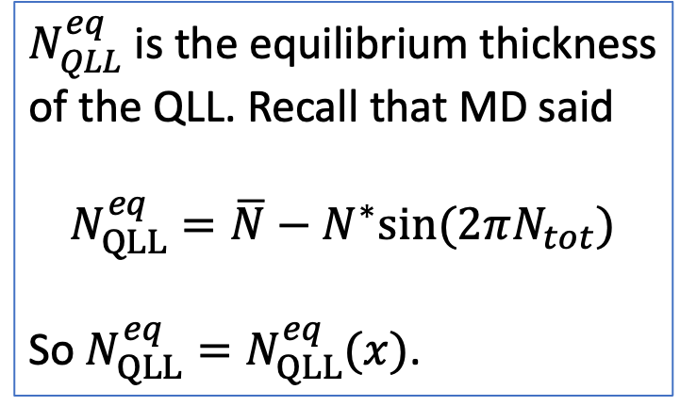
Interconversion of quasi-liquid with the underlying ice lattice
$\frac{{∂N}_{tot}}{∂t}={c_{δ}^{2}D}_{QLL}∇^{2}N_{QLL}+ν_{kin} σ_{m}$
$\frac{{∂N}_{QLL}}{∂t}=\frac{{∂N}_{tot}}{∂t}−\left(N_{QLL}−N_{QLL}^{eq}\right)/τ$
$N_{QLL}^{eq}$ is the equilibrium thickness of the QLL. Recall that MD said
$$N_{QLL}^{eq}=\overline{N}−N^{∗}sin⁡(2πN_{tot})$$
So $N_{QLL}^{eq}=N_{QLL}^{eq}(x)$.

Slide 15
Surface diffusion of the QLL
$\frac{{∂N}_{tot}}{∂t}={c_{δ}^{2}D}_{QLL}∇^{2}N_{QLL}+ν_{kin} σ_{m}$
$\frac{{∂N}_{QLL}}{∂t}=\frac{{∂N}_{tot}}{∂t}−\left(N_{QLL}−N_{QLL}^{eq}\right)/τ$

Slide 16
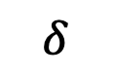
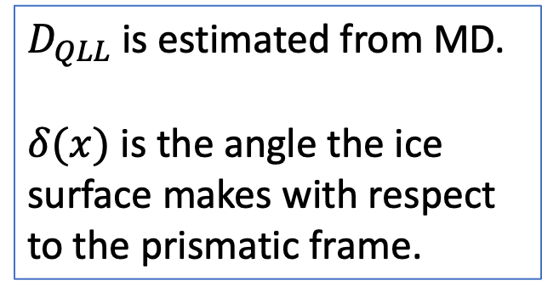
Surface diffusion of the QLL
$\frac{{∂N}_{tot}}{∂t}={c_{δ}^{2}D}_{QLL}∇^{2}N_{QLL}+ν_{kin} σ_{m}$
$\frac{{∂N}_{QLL}}{∂t}=\frac{{∂N}_{tot}}{∂t}−\left(N_{QLL}−N_{QLL}^{eq}\right)/τ$
$D_{QLL}$ is estimated from MD.
$δ(x)$ is the angle the ice surface makes with respect to the prismatic frame.
$$δ$$

Slide 17
Exchange with the overlying water vapor
$\frac{{∂N}_{tot}}{∂t}={c_{δ}^{2}D}_{QLL}∇^{2}N_{QLL}+ν_{kin} σ_{m}$
$\frac{{∂N}_{QLL}}{∂t}=\frac{{∂N}_{tot}}{∂t}−\left(N_{QLL}−N_{QLL}^{eq}\right)/τ$

Slide 18
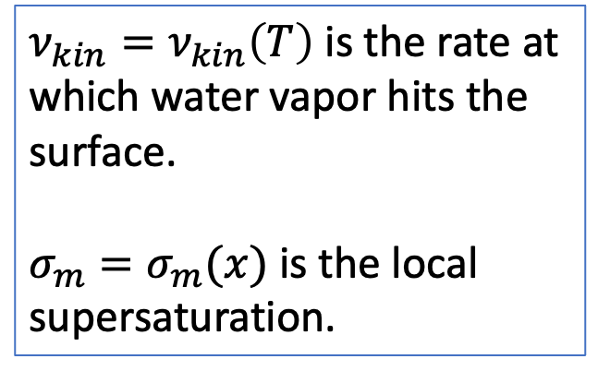
Exchange with the overlying water vapor
$\frac{{∂N}_{tot}}{∂t}={c_{δ}^{2}D}_{QLL}∇^{2}N_{QLL}+ν_{kin} σ_{m}$
$\frac{{∂N}_{QLL}}{∂t}=\frac{{∂N}_{tot}}{∂t}−\left(N_{QLL}−N_{QLL}^{eq}\right)/τ$
$ν_{kin}=ν_{kin}\left(T\right)$ is the rate at which water vapor hits the surface.
$σ_{m}=σ_{m}(x)$ is the local supersaturation.

Slide 19
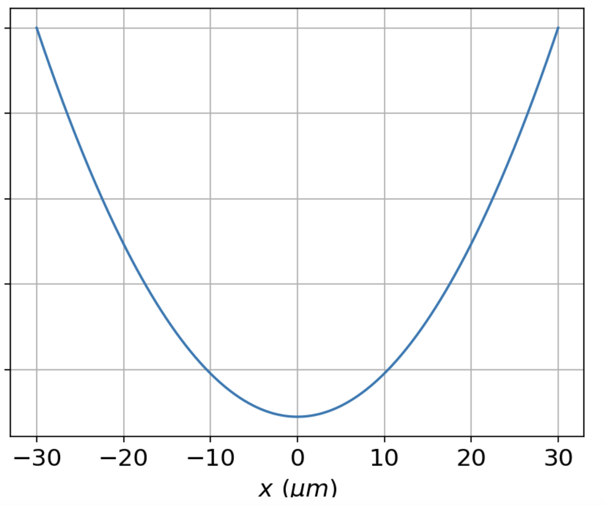

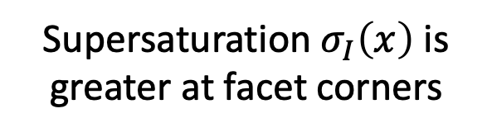

A little more explanation of $σ_{m}$ … it depends on the overlying vapor pressure, $σ_{I}\left(x\right)$
Higher $P_{vap}$
Supersaturation $σ_{I}\left(x\right)$ is greater at facet corners
Ice crystal
(2D)

Slide 20
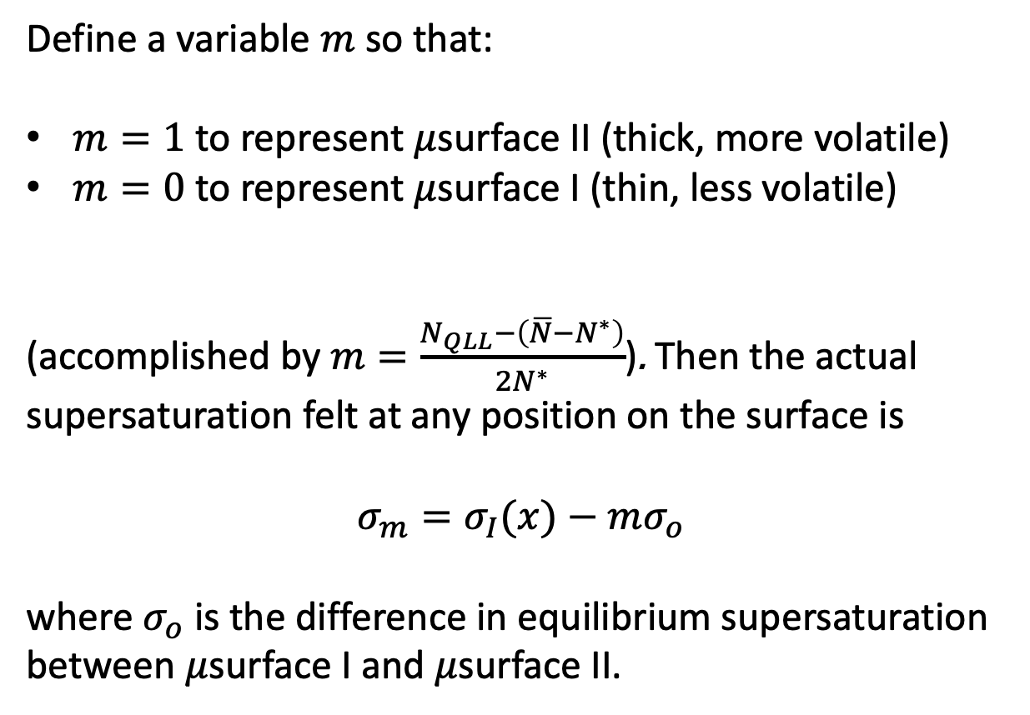
But $σ_{m}$ also depends on the state of the QLL
Define a variable $m$ so that:
$m=1$ to represent $μ$surface II (thick, more volatile)
$m=0$ to represent $μ$surface I (thin, less volatile)
(accomplished by $m=\frac{N_{QLL}−\left(\overline{N}−N^{∗}\right)}{2N^{∗}}$). Then the actual supersaturation felt at any position on the surface is
$$σ_{m}=σ_{I}(x)−mσ_{o}$$
where $σ_{o}$ is the difference in equilibrium supersaturation between $μ$surface I and $μ$surface II.

Slide 21
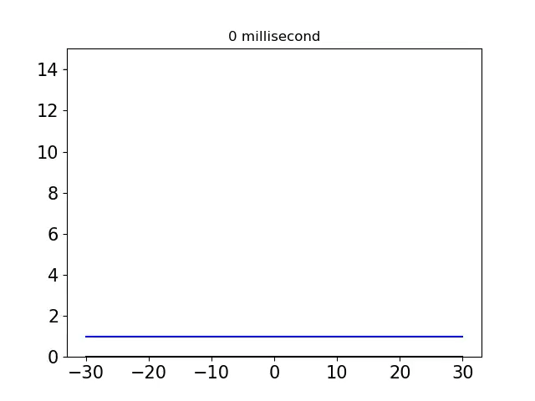
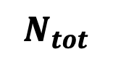
OK, let’s look at some results – solving the PDE starting with a flat surface
$$N_{tot}$$

Slide 22
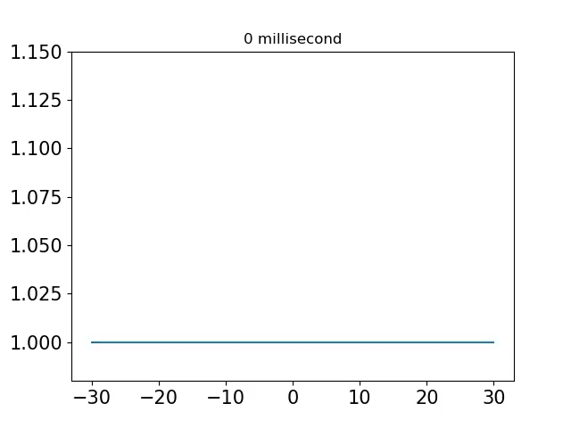
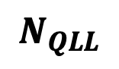
OK, let’s look at some results – solving the PDE starting with a flat surface
$$N_{QLL}$$

Slide 23
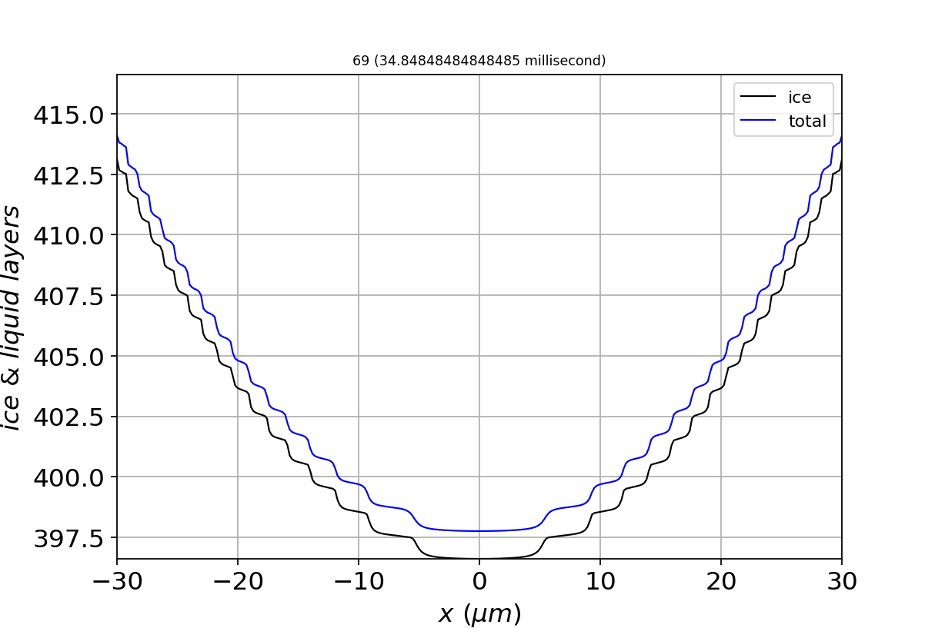
Considering $N_{tot}$and $N_{QLL}$together => steps correspond to mainly $μ$surface I (thin QLL)

Slide 24
Considering $N_{tot}$and $N_{QLL}$together => terraces correspond to mainly $μ$surface II (thick QLL)

Slide 25
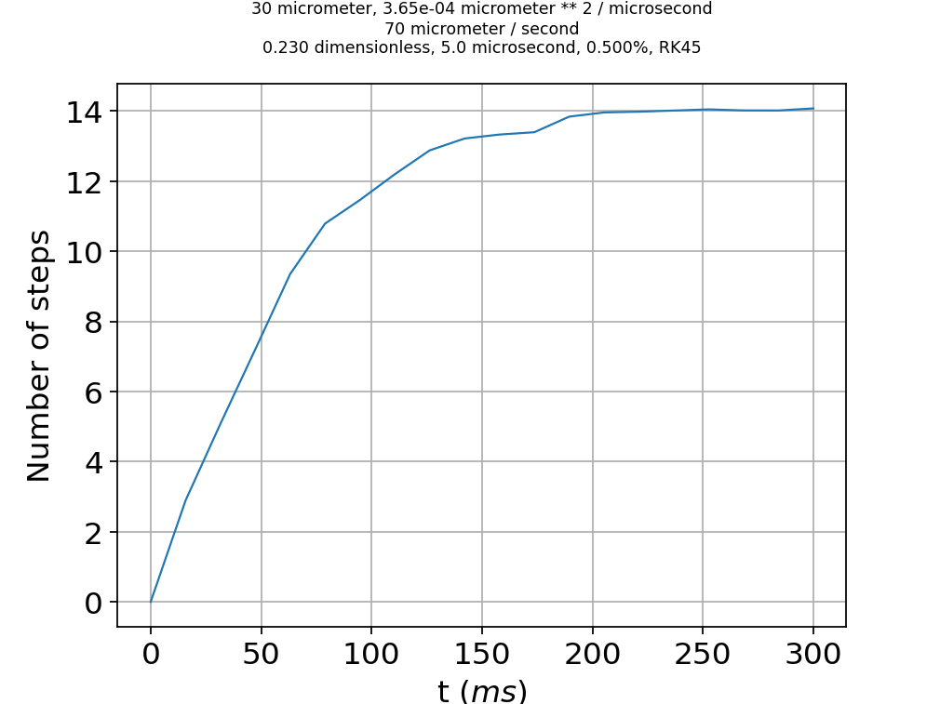
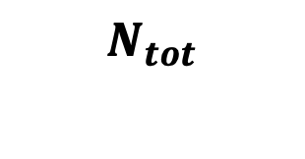
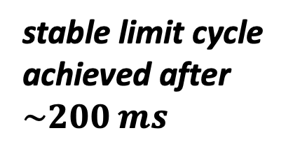
After long enough time, a stable limit cycle emerges
$$N_{tot}$$
stable limit cycle achieved after $\sim 200 ms$

Slide 26
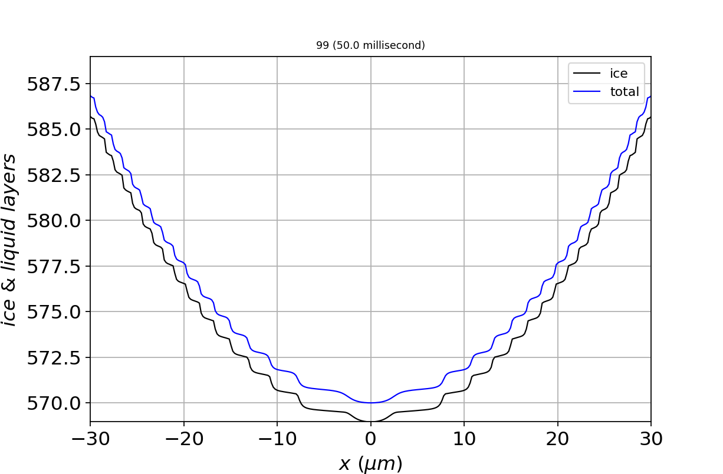
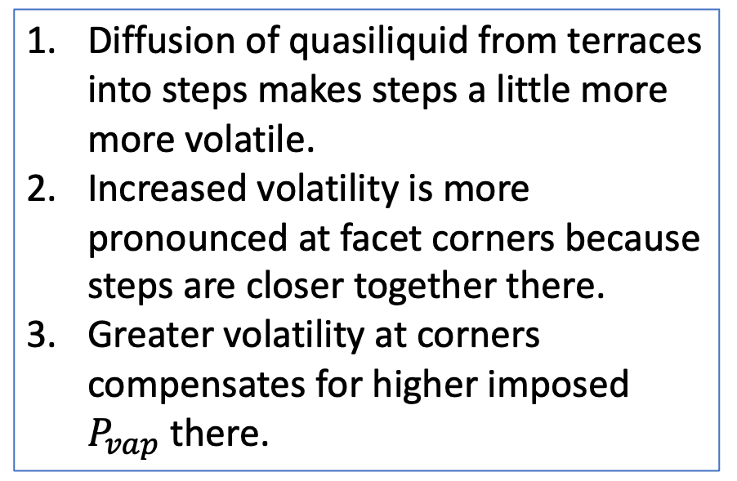
Mechanism: surface diffusion modifies the surface in response to vapor inhomogeneity
Diffusion of quasiliquid from terraces into steps makes steps a little more more volatile.
Increased volatility is more pronounced at facet corners because steps are closer together there.
Greater volatility at corners compensates for higher imposed $P_{vap}$ there.

Slide 27
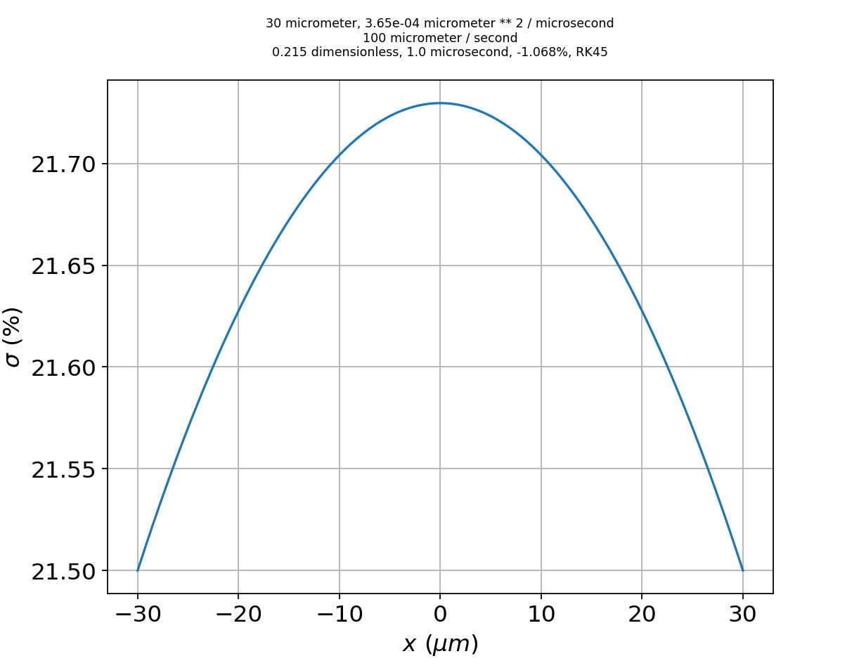
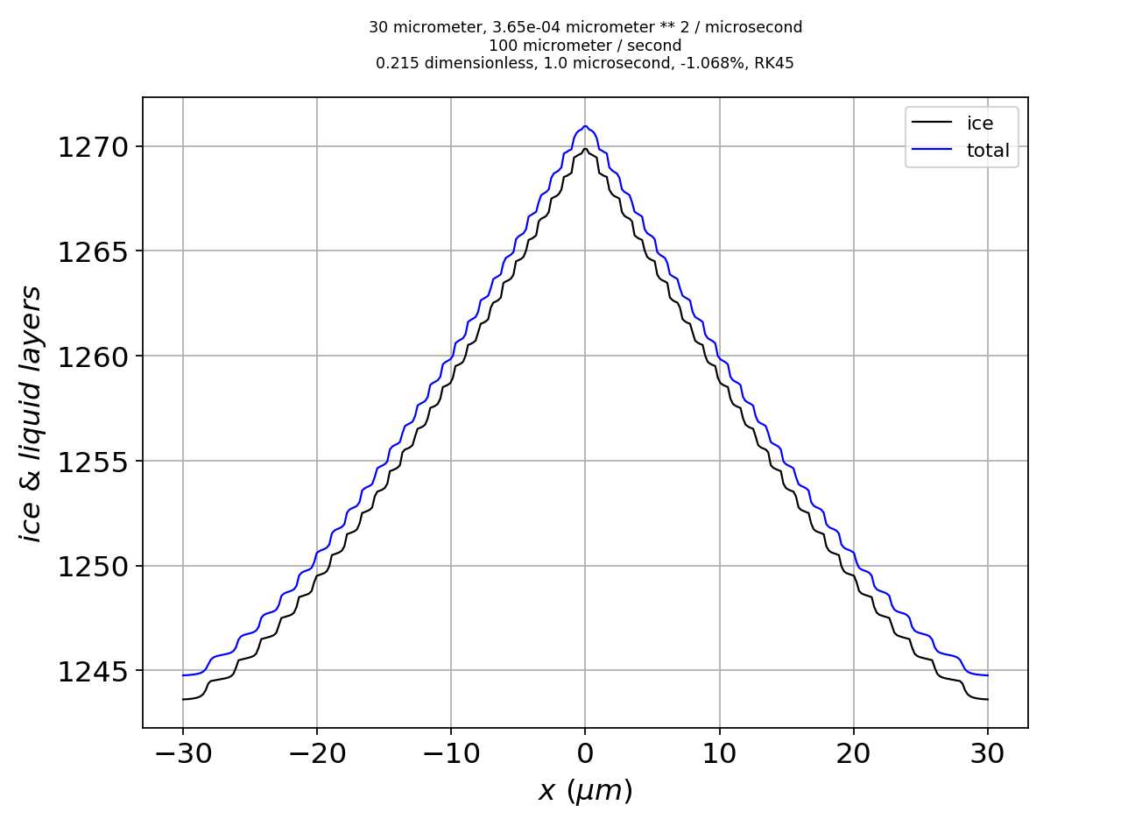
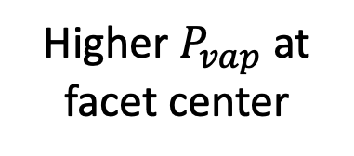
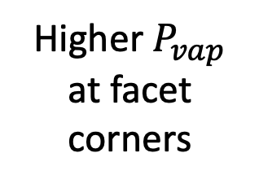
The same mechanism works with any smooth inhomogeneity in the overlying vapor field
Imposed supersaturation
Higher $P_{vap}$ at facet corners
Higher $P_{vap}$ at facet center
Limit cycle with convex curvature
Shape of the converged surface
Limit cycle with concave curvature

Slide 28

Take-home lesson from Part 1: limit cycling explains faceted growth
$$<0.01 μm$$
1. Smooth faceted growth is the result of stable limit cycles that form as an emergent property of the dynamics of ice growth.
2. This emergence accommodates any smooth inhomogeneity in the overlying vapor field.
3. Modest curvature + equal growth rates across a facet => what appears (at the mesoscale) as faceted growth.

Slide 29

On to Part II
$$mesoscopic scale$$
(from scanning electron microscopy)
Part I:
How do growing ice surfaces remain flat?
Part II:
How do they become rough? (Actually, what is roughness?)
Molecular scale

Slide 30
Hypothesis: maybe roughness is “just” microfacets of other angles

Slide 31
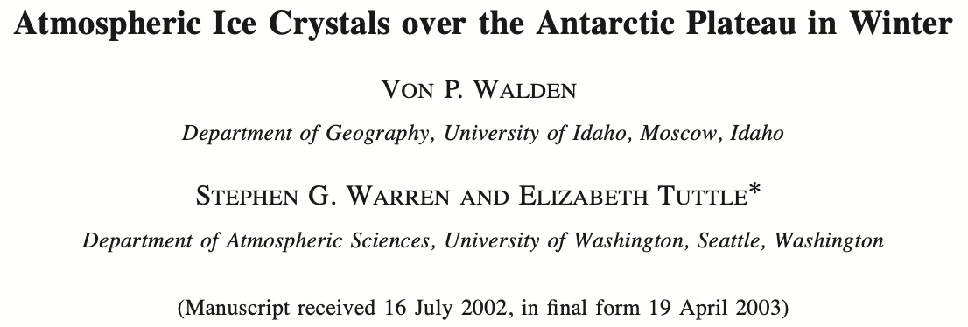
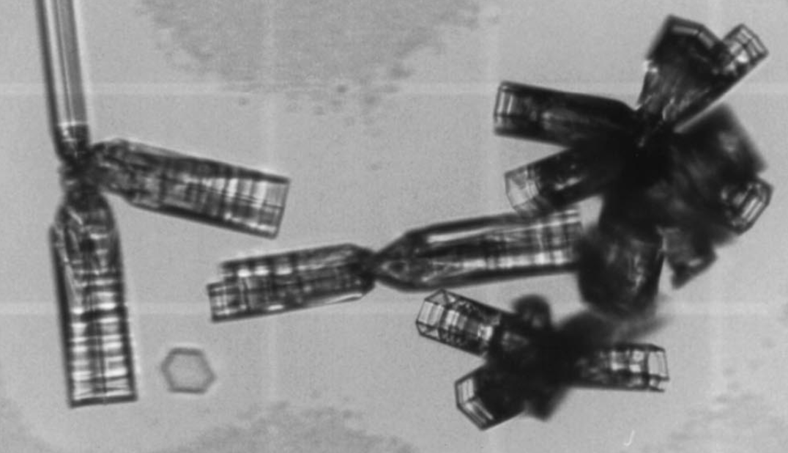
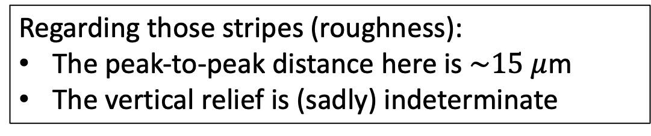
Why? Optical microscopy tells us there are characteristic peak-to-peak distances
Regarding those stripes (roughness):
The peak-to-peak distance here is $\sim 15 μ$m
The vertical relief is (sadly) indeterminate

Slide 32
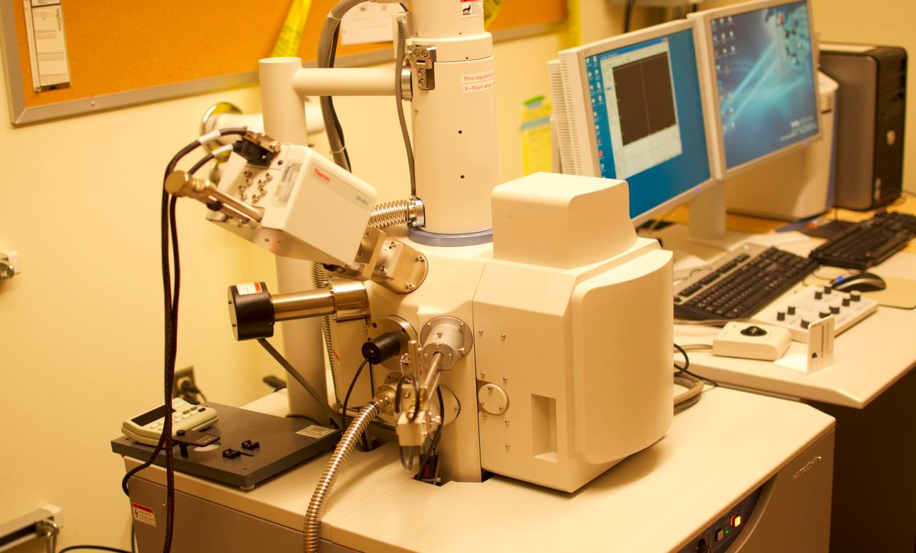

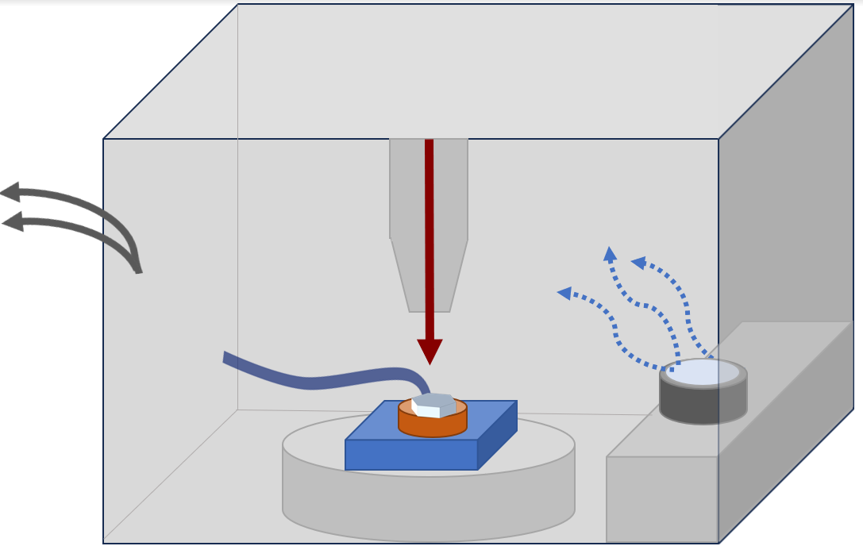
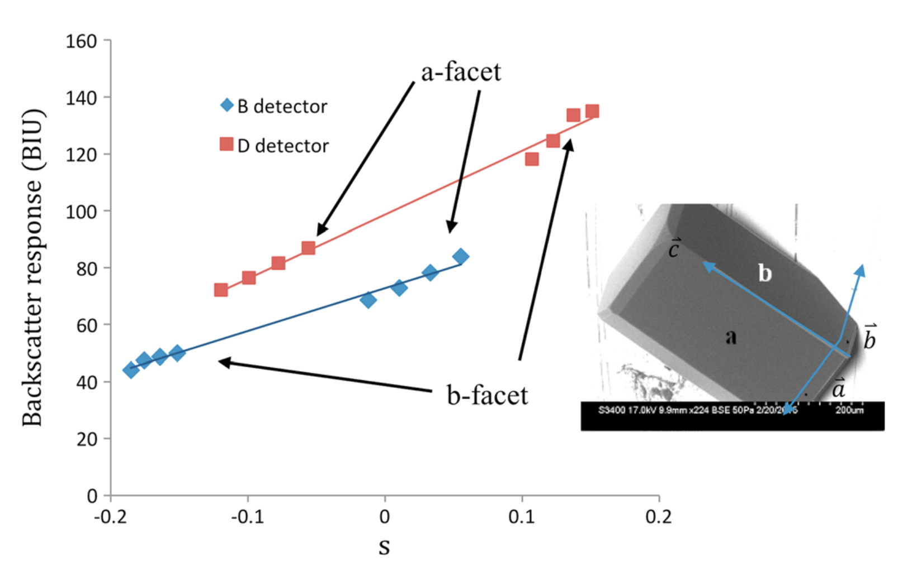
SEM/GNBF gives us the vertical relief
Vacuum

Slide 33
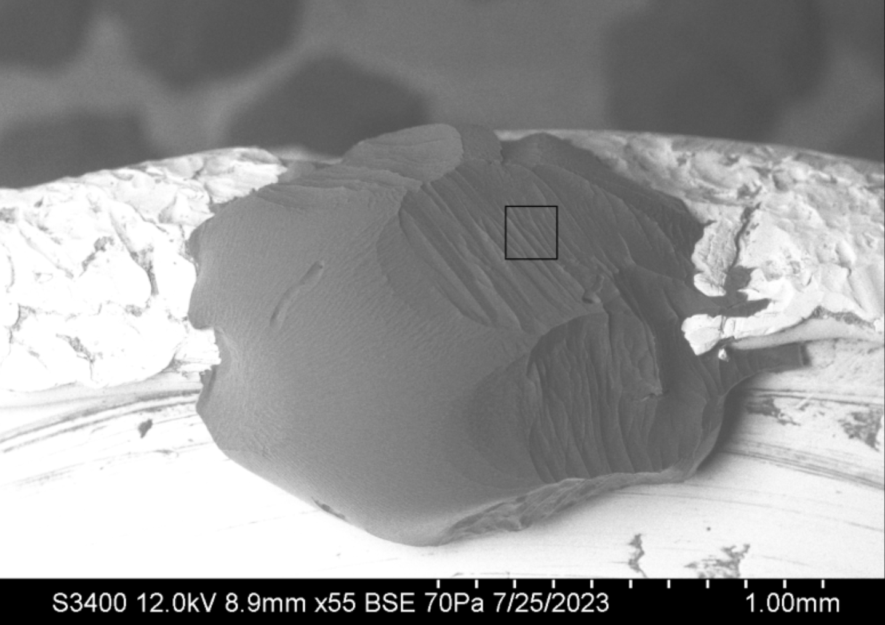
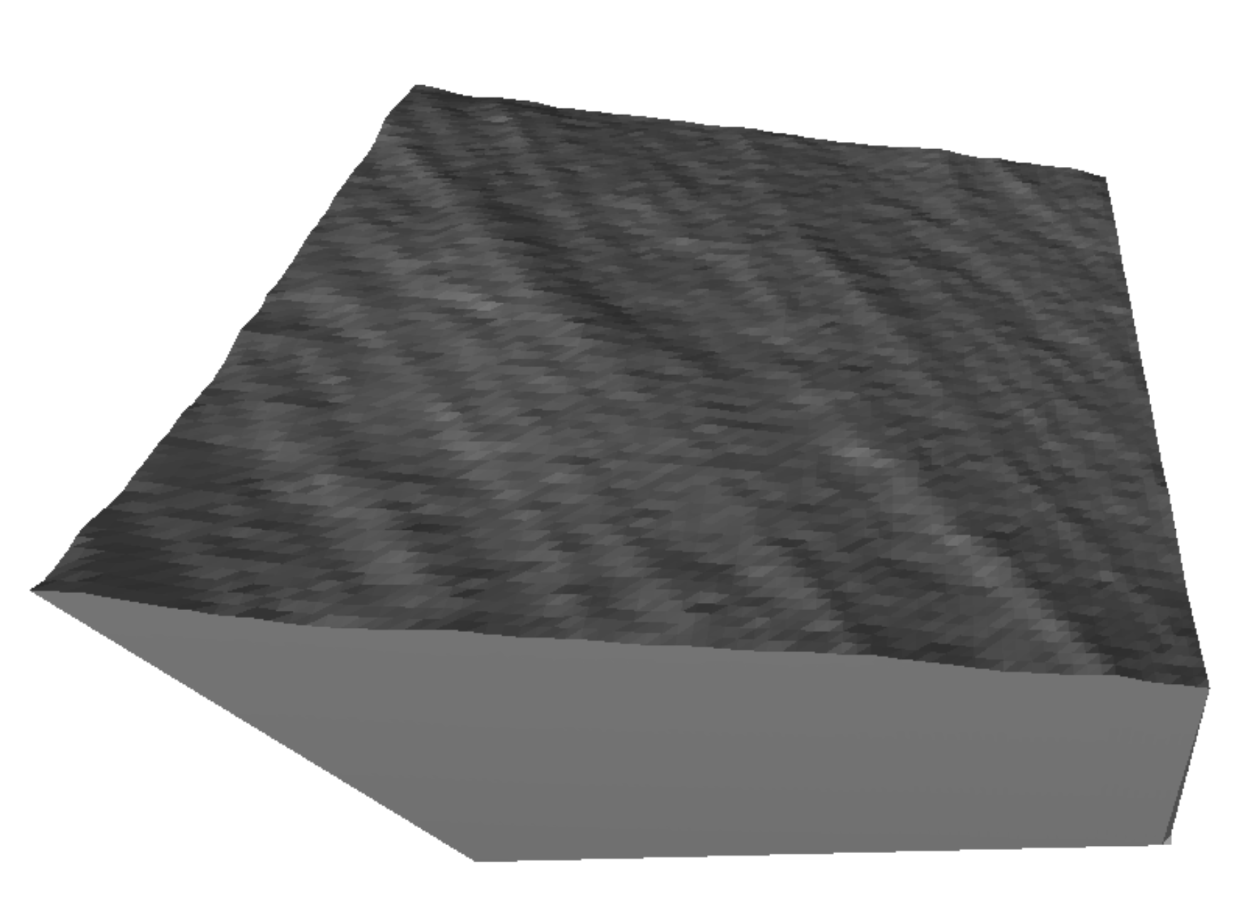


SEM/GNBF gives us the angles too
Horizontal Peak-to-peak distance $\sim 15 μ$m
Vertical relief $\sim 1−2 μ$m
=> Slope $\sim 10°$

Slide 34



SEM/GNBF gives us the angles too
Horizontal Peak-to-peak distance $\sim 50 μ$m
Vertical relief $\sim 7 μ$m
=> Slope $\sim 10°$

Slide 35

To enable microfaceting in the PDE, the basic idea is that the slope of the surface is key …
Ice surface
Prismatic monolayer ($h_{pr})$
At this point, the surface slope is close to the prismatic plane, so that point is “prismatic-like”.

Slide 36


Red lines indicate successive layers of a “pyramidal” facet plane
$$h_{θ}$$
$$θ$$
At this point, the surface slope is close to a positively-sloped (“pyramidal”) plane, so that point is “pyramidal-like”.

Slide 37

There’s also a negatively-sloped “pyramidal” facet plane
$$−θ$$
At this point, the surface slope is close to a negatively-sloped facet plane (“pyramidal”), so that point is “-pyramidal-like”.

Slide 38

Keep the form of the PDE, but replace $σ_{m}$ and $N_{QLL}^{eq}$ with slope-sensitive values
$$−θ$$
$\frac{{∂N}_{tot}}{∂t}={c_{δ}^{2}D}_{QLL}∇^{2}N_{QLL}+ν_{kin}$ ${\tilde{σ}}_{m}(x)$
$\frac{{∂N}_{QLL}}{∂t}=\frac{{∂N}_{tot}}{∂t}−\left({∂N}_{QLL}−{\tilde{N}}_{QLL}^{eq}(x)\right)/τ$

Slide 39

For ${\tilde{N}}_{QLL}^{eq}$: First we need to compute the layer thicknesses ($N_{tot}$) at each grid point
$$θ$$
$$N_{QLL,pr}^{eq}(x)=\overline{N}−N_{pr}^{∗}sin⁡(2πN_{tot,pr}(x))$$
$$N_{QLL,±θ}^{eq}(x)=\overline{N}−N_{±θ}^{∗}\sin\left(2πN_{tot,±θ}(x)\right)$$
E.g, at the dot, $N_{tot,pr}=3$ and $N_{tot,θ}=2$
Generally: $N_{tot,±θ}(x)=\frac{1}{h_{θ}}\left(c_{θ}h_{pr}N_{tot,pr}±s_{θ}x\right)$

Slide 40
We’ll skip the next few slides
There’s a lotta math in the next few slides, we’ll come back to them later.

Slide 41
For ${\tilde{N}}_{QLL}^{eq}$: Then we’ll weight them (“$α$”)
$$θ$$
$${\tilde{N}}_{QLL}^{eq}(x)={{α_{θ}N}_{QLL,θ}^{eq}\left(x\right)+α_{pr}N}_{QLL,pr}^{eq}\left(x\right)+{α_{−θ}N}_{QLL,−θ}^{eq}(x)$$

Slide 42

For ${\tilde{σ}}_{m}$: Each facet angle gets an $N^{∗}$ and $σ_{o}$
$$θ$$
$σ_{m,pr}\left(x\right)=σ_{I}\left(x\right)−\frac{N_{QLL}(x)−\left(\overline{N}−N_{pr}^{∗}\right)}{2N_{pr}^{∗}}σ_{o,pr}$
$σ_{m,±θ}\left(x\right)=σ_{I}\left(x\right)−\frac{N_{QLL}(x)−\left(\overline{N}−N_{±θ}^{∗}\right)}{2N_{±θ}^{∗}}σ_{o,±θ}$

Slide 43
For ${\tilde{σ}}_{m}$: Then we’ll weight them (“$α$”)
$$θ$$
${\tilde{σ}}_{m}={α_{θ}σ}_{m,θ}+α_{pr}σ_{m,pr}+{α_{−θ}σ}_{m,−θ}$

Slide 44


We need those weights $α_{±θ}$ & $α_{pr}$
Slopes: $\frac{dz_{pr}}{dx}≡β$
$$θ$$
Each grid point has a slope ($β$)

Slide 45
Assign the weights according to the slope of the surface
Slopes: $\frac{dz_{pr}}{dx}≡β$
$$θ$$
Here, $β≈β_{θ}$, so the grid point aligns with the positively-sloped $θ$ (“pyramidal”) facet

Slide 46
Assign the weights according to the slope of the surface
Slopes: $\frac{dz_{pr}}{dx}≡β$
$$θ$$
Here, $β≈0$, so we’d say the grid point aligns best with the original facet (prismatic)

Slide 47
Assign the weights according to the slope of the surface
Slopes: $\frac{dz_{pr}}{dx}≡β$
$$θ$$
$β≈{−β}_{θ}$ so the grid point aligns with the negatively-sloped $θ$ facet

Slide 48






Assign weights using sigmoid functions ($α_{θ}$, $α_{pr}$, $α_{−θ}$)
$$α_{θ}≈0.9$$
$α_{pr}$ $≈0.1$
$α_{−θ}≈0.0$
$$α\left(β\right)=1−\frac{1}{1+e^{−\frac{β−β_{θ/2}}{∆β}}}$$
$${−β}_{θ/2}$$
$$0$$
$$β_{θ/2}$$

Slide 49
Pick up again below here

Slide 50
Each grid point is assigned a set of weights ($α_{pr}$, $α_{θ}$, $α_{−θ}$)
$$α_{θ}≈0.9$$
$α_{pr}$ $≈0.1$
$α_{−θ}≈0.0$
$$θ$$

Slide 51


Replace $σ_{m}$ and $N_{QLL}^{eq}$ with ${\tilde{σ}}_{m}$ and ${\tilde{N}}_{QLL}^{eq}$
$$α_{θ}≈0.9$$
$α_{pr}$ $≈0.1$
$α_{−θ}≈0.0$
$$θ$$
$\frac{{∂N}_{tot}}{∂t}={c_{δ}^{2}D}_{QLL}∇^{2}N_{QLL}+ν_{kin}$ ${\tilde{σ}}_{m}(x)$
$\frac{{∂N}_{QLL}}{∂t}=\frac{{∂N}_{tot}}{∂t}−\left({∂N}_{QLL}−{\tilde{N}}_{QLL}^{eq}(x)\right)/τ$
$${α_{θ}σ}_{m,θ}+α_{pr}σ_{m,pr}+{α_{−θ}σ}_{m,−θ}$$
$${{α_{θ}N}_{QLL,θ}^{eq}+α_{pr}N}_{QLL,pr}^{eq}+{α_{−θ}N}_{QLL,−θ}^{eq}$$

Slide 52









Results: given the same parameters, the microfacet-enabled PDE results in limit cycles a lot like the prismatic-only version
$$N_{QLL}$$
Number of steps
Original PDE
(at $6 ms$)
$5°$ microfacet-enabled
(at $6 ms$)

Slide 53





Non-growable $θ=±5°$ microfaceting, high-deposition rate
$$N_{tot} (μm)$$
Notes: $σ_{o}$ of these microfacets is high enough that:
Supersaturation is less than that of the equilibrium value of $θ$’s $μ$surface II => the microfacets can’t grow
Supersaturation is greater than the equilibrium value of $θ$’s $μ$surface I => the microfacets can’t ablate either
=> A steady state results.

Slide 54


Non-growable $θ=±5°$ microfaceting, high-deposition rate
$$N_{QLL} (layers)$$
Notes: $σ_{o}$ of these microfacets is high enough that:
Supersaturation is less than that of the equilibrium value of $θ$’s $μ$surface II => the microfacets can’t grow
Supersaturation is greater than the equilibrium value of $θ$’s $μ$surface I => the microfacets can’t ablate either
=> A steady state results.

Slide 55


Growable $θ=±5°$ microfaceting, fast-growth conditions
$$N_{tot} (μm)$$
Notes: $σ_{o}$ of these microfacets is low enough that even $θ$’s $μ$surface II can grow => A limit cycle results.

Slide 56

Growable $θ=±5°$ microfaceting, fast-growth conditions
$$N_{QLL} (layers)$$
Notes: $σ_{o}$ of these microfacets is low enough that even $θ$’s $μ$surface II can grow => A limit cycle results.

Slide 57



Non-growable $θ=±10°$ microfaceting, high-deposition rate
$$N_{tot} (μm)$$
Notes: $σ_{o}$ of these microfacets is high enough that:
Supersaturation is less than that of the equilibrium value of $θ$’s $μ$surface II => the microfacets can’t grow
Supersaturation is greater than the equilibrium value of $θ$’s $μ$surface I => the microfacets can’t ablate either
=> A steady state results.

Slide 58


Non-growable $θ=±10°$ microfaceting, high-deposition rate
$$N_{QLL} (layers)$$
Notes: $σ_{o}$ of these microfacets is high enough that:
Supersaturation is less than that of the equilibrium value of $θ$’s $μ$surface II => the microfacets can’t grow
Supersaturation is greater than the equilibrium value of $θ$’s $μ$surface I => the microfacets can’t ablate either
=> A steady state results.

Slide 59

Growable $θ=±5°$ microfaceting, high-deposition rate
$$N_{tot} (μm)$$
Notes: $σ_{o}$ of these microfacets is low enough that even $θ$’s $μ$surface II can grow => A limit cycle results.

Slide 60

Take-home lessons
From Part I:
1. Smooth faceted growth is the result of stable limit cycles that form as an emergent property of the dynamics of ice growth.
2. This emergence accommodates any smooth inhomogeneity in the overlying vapor field.
3. Modest curvature + equal growth rates across a facet => what appears (at the mesoscale) as faceted growth.
From Part II:
1. Roughness is consistent with microfacet formation modulating otherwise flat faceted surfaces.
2. Microfacets stabilize the surface in that they enable steady-state profiles in some conditions, and limit cycle profiles in others.
3. Available in situ (visible, SEM/GNBF) experiments suggest a predominance of $θ≈10°$ microfaceting on prismatic facets in the principle (c) axis direction.

Slide 61




Going forward …
Model:
How do the surrounding vapor fields really vary for growing or ablating crystals?
What insights might a Fourier formulation provide?
What about a PDE for two-dimensional crystal surfaces?
Observations:
What range are observed microfacet angles?
What happens in subsaturated conditions?
More broadly:
Can we use this theory to predict optical properties of cirrus ice in a way that’s useful to climate science?
Atmospheric

Slide 62




Thanks for listening!
$\frac{{∂N}_{tot}}{∂t}={c_{δ}^{2}D}_{QLL}∇^{2}N_{QLL}+ν_{kin}$ ${\tilde{σ}}_{m}$
$\frac{{∂N}_{QLL}}{∂t}=\frac{{∂N}_{tot}}{∂t}−\left({∂N}_{QLL}−{\tilde{N}}_{QLL}^{eq}\right)/τ$

Slide 63


We do get positive curvature on “flat” basal facets, although it’s a lot bigger and bumpier than stable limit-cycle theory predicts

Slide 64


The beginnings of hollowing when $ν_{kin}$ gets big (higher temperature)
$$≈0.2 μm$$

Slide 65



Molecular Dynamics studies of ice surfaces
December 2016

Slide 66






$θ=±10°$ microfaceting enabled, after 10 seconds simulated time (w/o D correction)
The vertical scale is in $μm$ here, x1000s greater than what I showed you before; it would be visible on a microscopic (e.g., SEM) scale.
It would develop a steady state.
$${h_{pr}N}_{tot,pr}$$

Slide 67





Steps are characterized by thin quasiliquid (i.e., $μ$surface I)
$μ$surface I
$$N_{tot}$$
$$N_{QLL}$$

Slide 68
Steps are characterized by thin quasiliquid (i.e., $μ$surface I)
$μ$surface I
$$N_{tot}$$
$$N_{QLL}$$

Slide 69
Steps are characterized by thin quasiliquid (i.e., $μ$surface I)
$μ$surface I
$$N_{tot}$$
$$N_{QLL}$$

Slide 70

Terraces are characterized by thick quasiliquid (i.e., $μ$surface II)
$μ$surface II
$$N_{tot}$$
$$N_{QLL}$$

Slide 71
Terraces are characterized by thick quasiliquid (i.e., $μ$surface II)
$μ$surface II
$$N_{tot}$$
$$N_{QLL}$$

Slide 72
Terraces are characterized by thick quasiliquid (i.e., $μ$surface II)
$μ$surface II
$$N_{tot}$$
$$N_{QLL}$$

